Slide 1
Cardinality & Participation Constraint in DBMS

Slide 2
Relationship Constraints
We can distinguish two main types of relationship constraints: •Cardinality constraints •Participation constraint

Slide 3
Requirements for analysis
Requirement Analysis: •Every employee work for one department •An department can have many employees •New department need not have employee Degree: In every relationship how many entities are participating.

Slide 4
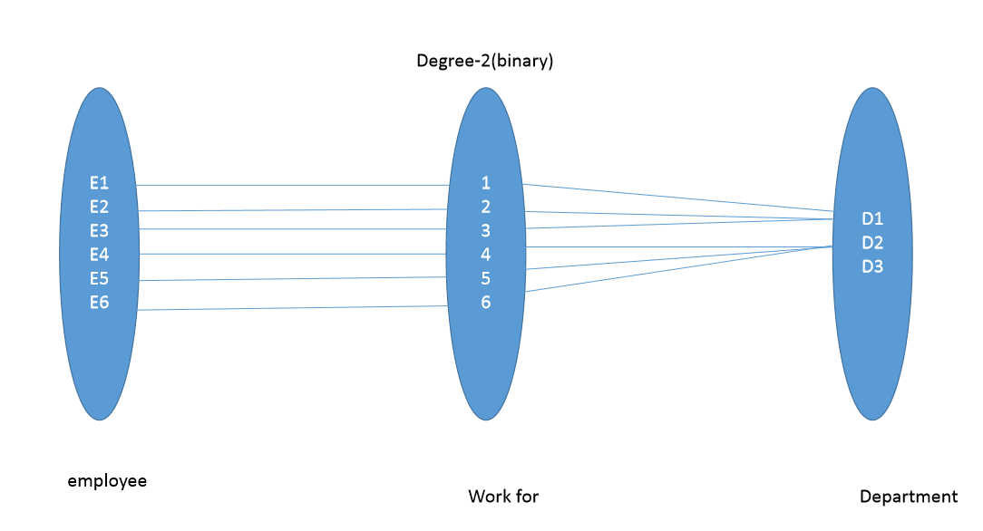
Relationship

Slide 5
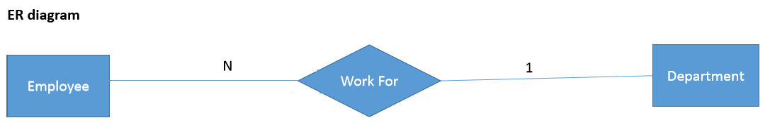
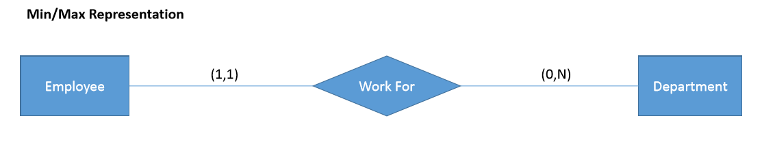
Representation

Slide 6
Requirement Analysis
Every Department should have a manager & only one employee manages a department.
An Employee can manage only one department

Slide 7
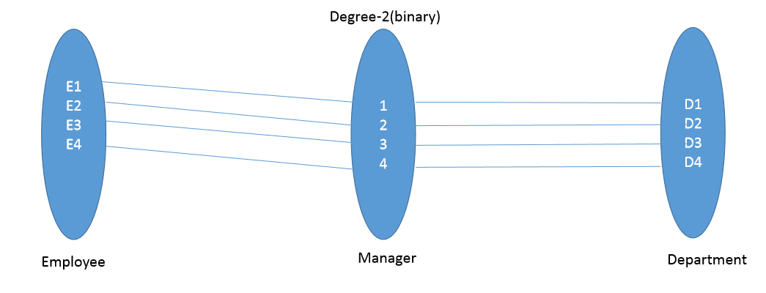
Relationship

Slide 8
Cardinality
The term cardinality actually has two different meanings depending on the context of it’s usage – one meaning is in the context of Data modeling and the other meaning is in the context of SQL statements.

Slide 9
In The Context Of Data Modeling
It simply refers to the relationship that one table can have with another table Classification / Degree Of Cardinality One-to-One (1:1):One occurrence of an entity relates to only one occurrence in another entity. One-to-Many (1:M): One occurrence in an entity relates to many occurrences in another entity. Many-to-Many (M:N) Many occurrences in an entity relate to many occurrences in another entity.

Slide 10
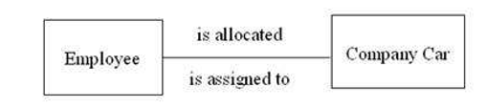
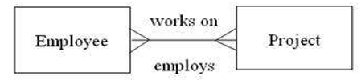
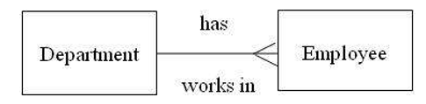
Three degrees of Cardinality
One-to-One (1:1):One occurrence of an entity relates to only one occurrence in another entity.
One-to-Many (1:M): One occurrence in an entity relates to many occurrences in another entity.
Many-to-Many (M:N) Many occurrences in an entity relate to many occurrences in another entity.

Slide 11
Requirement Analysis
Employee belongs to the department, some of the employees are new and having no department. An employee is not belongs to more than one department at the same time.
Employee salary is maintained on monthly basis. Therefore new employee might not have the salaries for the current month.
Every employee participating in a team. Each employee participate in a single team.
These teams are managed by the employees, an employee can manage the single team.

Slide 12
Cardinality in SQL
Cardinality refers to the uniqueness of data contained in a column. If a column has a lot of duplicate data (e.g. a column that stores either "true" or "false"),it has low cardinality, but if the values are highly unique (e.g. Social Security numbers), it has high cardinality

Slide 13
Cardinality in SQL
For example,
let’s say we have a table with a “Gender” column which has only two possible values of “Male” and “Female”.
Then, that “Gender” column would have a cardinality of 2, because there are only two unique values that could possibly appear in that column .

Slide 14
Cardinality in SQL
Let’s say that we have a primary key column on a table with 10,000 rows. What do you think the cardinality of that column would be?
Primary key: It is a key in a relational database that is unique for each record.

Slide 15
Participation Constraint
There are two types of participation constraints—total and partial. The participation of an entity set E in a relationship set R is said to be total if every entity in E participates in at least one relationship in R. If only some entities in E participate in relationships in R, the participation of entity set E in relationship R is said to be partial.

Slide 16
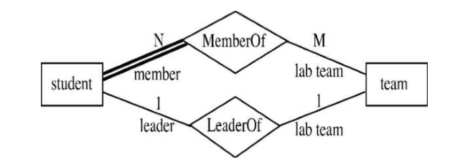
Participation Constraint (In ER Model)
Double line indicates the total participation constraint in an ER model. Single line indicates the partial participation constraint in an ER model.

